Slide 1
Genitourinary syndrome of Menopause
Dr. Fatemeh Mallah
Tabriz University Of Medical Sciences
Fellowship of Pelvic Floor Disorders
5/10/1399

Slide 2
Introduction
Genitourinary syndrome of menopause (GMS) describes the symptoms and signs resulting from the effect of estrogen deficiency on the vagina, labia, clitoris, vestibule, urethra and bladder.
The syndrome may include:
-dryness, burning, irritation
-dysuria, urgency, and recurrent urinary tract infections
-sexual symptoms of pain and dryness

Slide 3
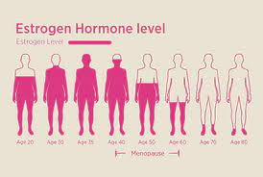
Pathophysiology
Decline in serum estrogen levels
(Estrogen receptor is present in the vagina, vulva, urethra, and trigone of the bladder)

Slide 4
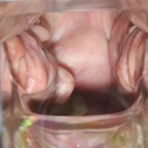
Effects of hypoestrogenism
Thinning of the top layer of superficial epithelial cells; absent in women with severe atrophy
Loss of rugae
Loss of elasticity of the vaginal epithelium
Shortening and narrowing of the vaginal canal, with Increased subepithelial connective tissue
Reduction in vaginal secretions
Increase in vaginal pH to ≥5

Slide 5
Prevalence
-Vaginal dryness up to 85%
-Dyspareunia 29-59%
-Vaginal itching and irritation 26-77%
-…
The duration of hypoestrogenism is a major factor in the development and severity of GSM

Slide 6
Clinical presentation
Vulvovaginal dryness
Vulvovaginal burning
vaginal discharge
Vulvovaginal itching
Urinary tract symptoms (eg, urinary frequency, dysuria, urethral discomfort, hematuria, recurrent urinary tract infections)
Light bleeding after intercourse
dyspareunia
decreased vaginal lubrication during sexual activity

Slide 7
Evaluation
History:
asking menopausal women whether symptoms suggestive of GSM are present
The goal of the history is to determine whether symptoms of GSM are present, whether they are bothersome, and how they affect the woman’s sexual health and QOL

Slide 8
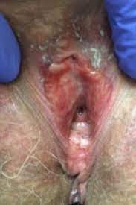
Evaluation
pelvic examination
reduced mons pubis and labia bulk,
erythema of the urethral meatus , urethral caruncle and prolapse
the vestibular tissue may become pale
Loss of vaginal rugae
Minimal blunt trauma from the speculum may result in petechiae or bleeding
shortening and narrowing of the vaginal canal and stenosis of the introitus and difficult to identify the cervix
labia majora may be fused

Slide 9
Laboratory testing?
Laboratory tests are usually not necessary for the diagnosis. Although the vaginal maturation index (VMI) and vaginal pH are routinely assessed in clinical trials, they are not essential to make a diagnosis of GSM in clinical practice

Slide 10
Differential diagnosis
Vaginitis
Allergic or inflammatory conditions (environmental agents and contact dermatitis, vulvar lichen sclerosus, Lichen planus,)
Genital tract ulcers or fissures may be due to systemic disease (eg, Crohn disease)
Genital tract bleeding may be due to trauma, infection, or malignancy
Vulvodynia
medical conditions

Slide 11
Diagnosis
GSM is a clinical diagnosis made in women who are in a hypoestrogenic state and have characteristic symptoms and findings on pelvic examinationLaboratory
tests to confirm hypoestrogenic findings are available, but such testing is typically not necessary

Slide 12
Treatment
First-line treatment : for mild symptoms includes nonhormonal vaginal lubricants and moisturizers(the only contraindication is allergy)
Second-line treatment: for moderate to severe and persistent symptoms :
vaginal estrogen
vaginal dehydroepiandrosterone
oral ospemifene

Slide 14
Vaginal estrogen cream
Premarin; 0.625 mg conjugated estrogens/1 g cream
The regimens recommended
for vulvovaginal atrophy are:
0.5 to 2.0 g of cream
intravaginally,
start vaginal estrogen creams
with daily dosing for two
weeks and then change to twice weekly

Slide 15
Vaginal estrogen cream
Low-dose vaginal estrogen is the most effective treatment for moderate to severe and persistent symptoms
Adverse effects
serum absorption
contraindications

Slide 16
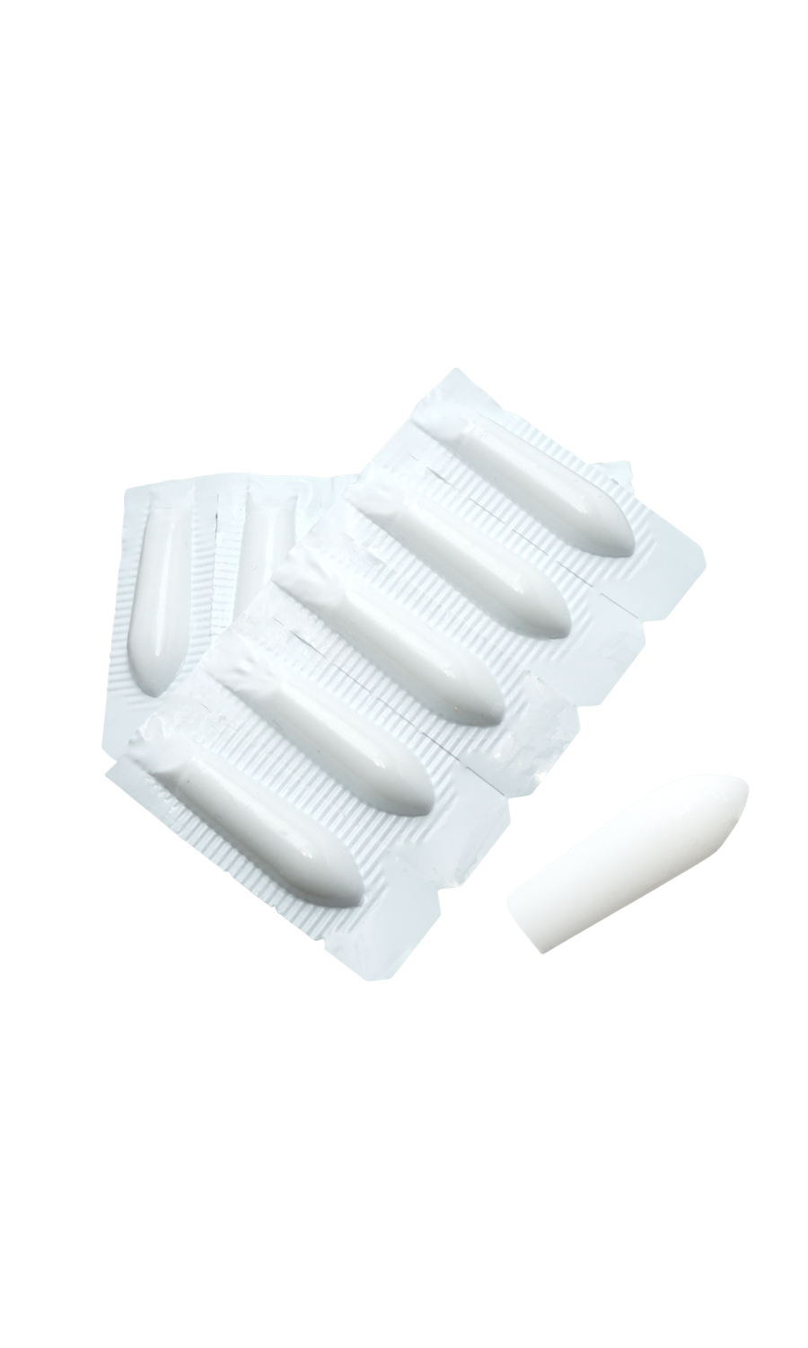
Dehydroepiandrosterone (prasterone)
Vaginal DHEA: treatment option for dyspareunia associated with GSM (6.5 mg daily vaginal suppository)
use of this treatment in patients with or at risk for estrogen-sensitive malignancies, particularly for those with breast cancer who are treated with an aromatase inhibitor (AI).

Slide 17
Ospemifene(SERM)
no clinically significant estrogenic effect on the endometrium or breast but an estrogen agonist in the vagina
For patients with symptomatic vulvovaginal atrophy that is not relieved with nonpharmacologic therapy, we suggest ospemifene rather than vaginal estrogen therapy for those who cannot (severe arthritis, obesity, vulvodynia) or prefer not to use a vaginal product.
disadvantages of ospemifene need for daily use and systemic side effects (hot flashes, potential risk of thromboembolism)

Slide 18
Therapies needing further evaluation
Laser and other energy-based devices
complementary therapies
oral vitamin D
vaginal vitamin E
oral and vaginal probiotics

Slide 19
Alternative Therapies
Pelvic physical therapy :(who do not respond to other therapies or who have contraindications to hormone therapy)
Vaginal dilators :introital stenosis, vaginal shortening/stenosis, contraindications to estrogen therapy and have failed moisturizers and lubricants.

Slide 20
Special Considerations
Asymptomatic patients
Prior to vulvovaginal surgery
Pelvic organ prolapse or urinary incontinence
who is currently sexually inactive and is planning to become sexually active
Patients with severe anatomic changes
Labial agglutination
Vaginal narrowing or shortening
urinary flow is impeded

Slide 21
Patients with breast cancer
nonhormonal options (eg, lubricants, moisturizers) are first-line therapy
For patients with breast cancer treated with selective estrogen receptor modulators:Low-dose vaginal estrogen or vaginal dehydroepiandrosterone (Grade 2C).
For patients with breast cancer treated with aromatase inhibitors (AIs):not using vaginal estrogen, DHEA

Slide 22
Summary And Recommendations
Genitourinary syndrome of menopause (GSM) is defined as a collection of symptoms and signs related to a decrease in estrogen and other sex steroids
For most patients with GSM, nonhormonal vaginal moisturizers and lubricants are the preferred approach to initial therapy.
For patients with GSM who are not adequately treated with vaginal moisturizers and lubricants, low-dose vaginal estrogen rather than dehydroepiandrosterone

Slide 23
Summary And Recommendations
For patients with GSM who want to avoid using vaginal estrogen but have no contraindications to estrogen itself and no objections to vaginal therapy, vaginal DHEA is an option
For patients with GSM who cannot or prefer not to use a vaginal product, oral ospemifene is an option.

Slide 24
Thank you for your attention

